Slide 1

Bangladesh Army University of Science and Technology (BAUST)
Saidpur Cantonment, Nilphamari
Department of Computer Science and Engineering (CSE)
Course Code: CSE 4140
Course Title: Machine Learning Sessional
Project- Diabetes Prediction Using Machine Learning
Date: 25-11-2025
Presented To:
1.Engr. Rohul Amin
-Lecturer Of CSE, BAUST
2. Nadim Reza
-Lecturer Of CSE, BAUST
Presented By:
Tamzid Shafayet, 220201001
Zerin Tasnim Trisha, 220201008

Slide 2

Outline
Introduction
Objectives
Related Works
Dataset
Methodology
Models Used
Comparison Table
Conclusion
References

Slide 3
Introduction
Diabetes is a chronic disease affecting millions worldwide.
Early prediction helps reduce severe health risks and complications.
Machine learning can identify hidden patterns in patient data.
Key Focus:
Identify diabetic vs. non-diabetic patients
Improve early prediction to reduce future health risks

Slide 4
Objectives
To predict patients who are likely to develop diabetes.
To analyze key health features that influence diabetes risk.
To apply machine learning algorithms for diabetes prediction.
To evaluate model performance using standard ML metrics.

Slide 5
Related Works
In [1], Smith et al., 2019
proposed a “Diabetes Prediction System Using Logistic Regression and Decision Trees.”
Shortcomings:
Very simple preprocessing; missing values not properly handled.
Limited feature engineering; only raw features used.
No ROC curve or AUC evaluation provided.
No comparison with advanced ensemble models.

Slide 6
Related Works(Cont.)
In [2], Tasin et al., 2022
developed “A Machine Learning-Based Approach for Diabetes Prediction.”
Shortcomings:
Heavy focus on Random Forest without testing simpler models.
Dataset imbalance not fully addressed.
Over-reliance on accuracy, fewer detailed metrics like Precision/Recall.
No learning curve or overfitting analysis.

Slide 7
Dataset
[3] Kaggle Diabetes Dataset
Total Samples: 769 patient records
Features: Glucose, BMI, Blood Pressure, Insulin, Age, Gender, Skin Thickness, Diabetes Pedigree Function
Target Variable: Outcome (0 = Non-Diabetic, 1 = Diabetic)
Dataset has slightly imbalanced classes.

Slide 8
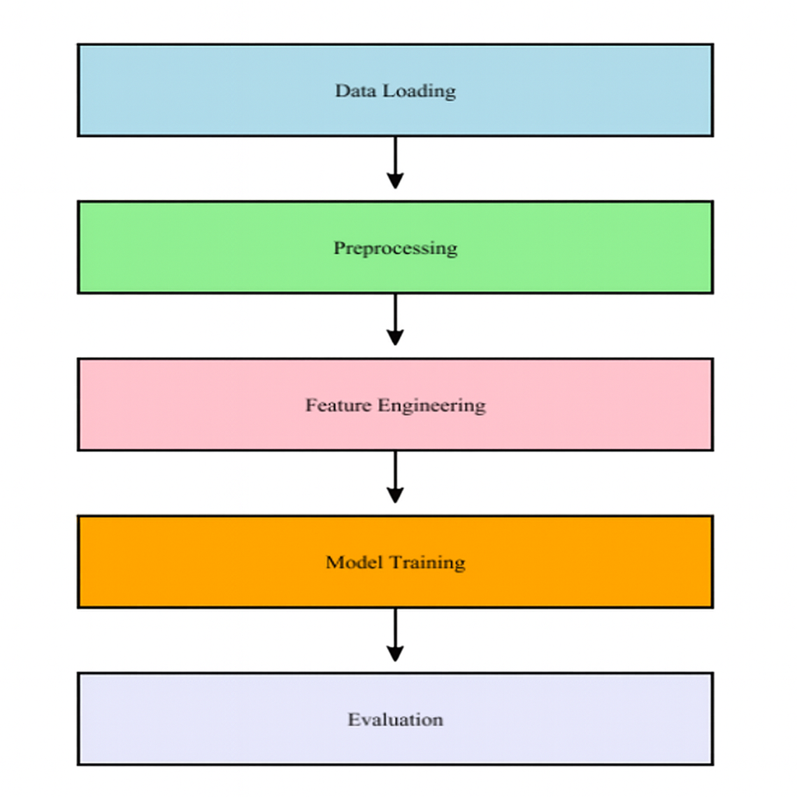
Methodology

Slide 9
Model Used
Logistic Regression
Random Forest

Slide 10
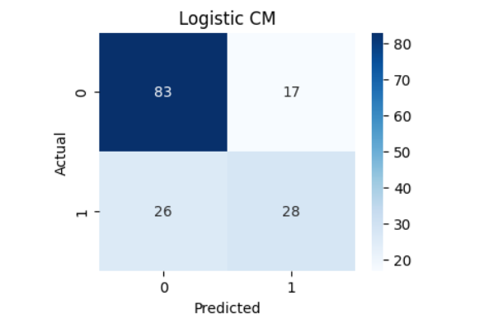
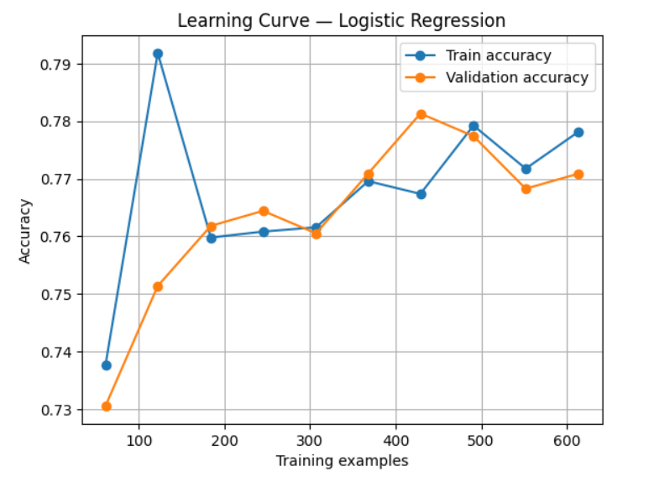
Model Used(Cont.)
Logistic Regression Results: Accuracy: 72%

Slide 11
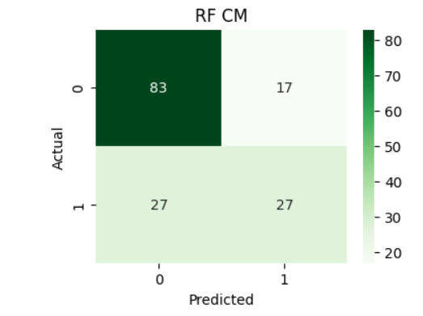
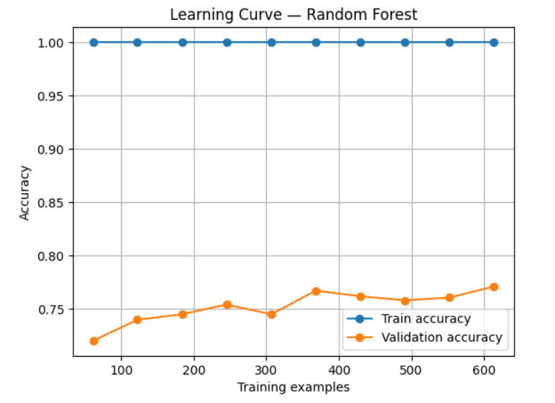
Model Used(Cont.)
Random Forest Results: Accuracy: 71%

Slide 12
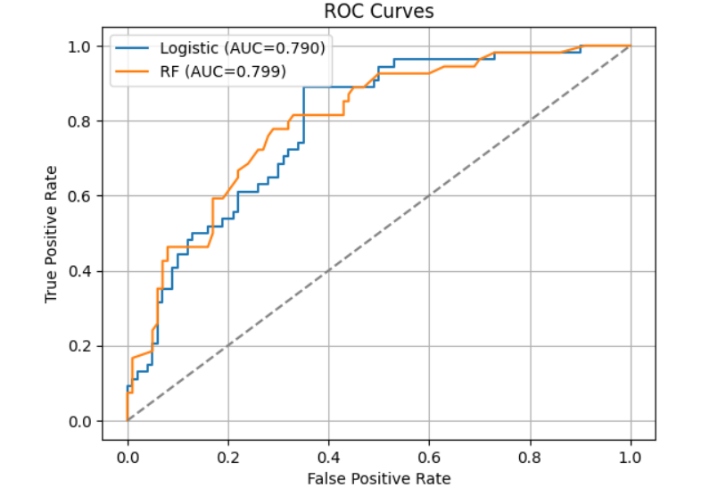
Model Used(Cont.)
ROC Curves:

Slide 13
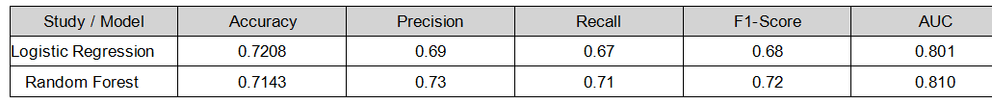
Comparison Table
Table:

Slide 14
Conclusion
Logistic Regression worked the best for predicting diabetes.
Random Forest was good but not as accurate as Logistic Regression.
The models improved a lot after cleaning the data and fixing wrong values.

Slide 15
References
Tasin et al., 2022 – Diabetes Prediction using ML.
Chang et al., 2022 – Pima Diabetes Analysis.
Ortega et al., 2025 – Ensemble ML for Diabetes.
American Diabetes Association (ADA).
Kaggle Diabetes Dataset,2025.

Slide 16

Assalamu-alaikum..

